Slide 1

ECON 1BB3 – Introduction to Macroeconomics
Notes:
Tiger Woods can mow his own lawn better than the neighbourhood kid, but it makes sense to pay the kid instead of doing it himself. Same idea as why import clothes from China.
He can make money rather than mowing lawn

Slide 2
Comparative advantage exercise:
Group A:
 | trucks | computers
Canada | 600 | 3000
Mexico | 300 | 1000
Group B:
 | trucks | computers
Canada | 600 | 3000
Mexico | 1000 | 1000
Notes:
If Canada produces only trucks, Canada can produce 600 and 0 computers.
If Canada produces only computers, Canada can produce 3000 computers and 0 trucks.

Slide 3
Comparative advantage exercise:
 | trucks | computers
Canada | 600(600) | 3000(3000)
Mexico | 300(1000) | 1000(1000)
trucks
computers
Notes:
It doesn’t matter which good goes on which axis.
If opportunity cost was not constant, PPF is curved outward. (more realistic)
→ Different resources in their economy is better for producing different thigns
If opportunity cost was constant, PPF is constant.
At top of curve, give up few truck builders, you build lots of computers
At the end of the curve, give up a few truck builds, you don’t build as much anymore
---------------------------
For side A: Canada is better producing both goods
When a country is better at producing both goods, they should not specialize in producing 1 good, instead they should produce both-more of the better good and less of the other good.
When a country is worse at producing both goods they should specialize in producing 1 good.

Slide 4
The Production Possibilities Frontier (PPF)
PPF: the combinations of output that the economy can produce given the available factors of production and production technology
Notes:
Holding constant labour supply, the amt of capital stock and technology, what are the possible combinations of goods can be produced? → this is what the PPF shows us

Slide 5
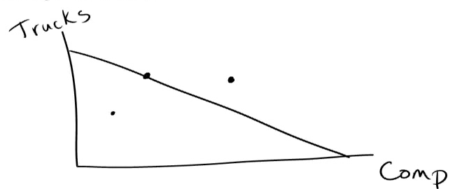
choose a point to consume in autarky
autarky: no trade
feasible: a combination that lies on the PPF or inside the PPF
infeasible: a combination that lies above the PPF
efficient: an outcome that occurs if the economy can get all it can from its scarce resources (better defined as: in order to get more of one thing, you have to give up another)
Notes:
Once drawn graph, choose a point in autarky (point on the line, anywhere actually, it’s by choice)
Choose a point on the graph, without trade.
Point inside the curve: feasible, inefficient
Point on the curve: efficient
Point outside the curve: infeasible
Any point on or inside PPF is feasible (what we can accomplish given the resources)
Outside curve: not feasible with current resources/technology
Inside curve: feasible b/c can make, but not best choice; not efficient
Efficient: if increasing output of trucks have to decrease computers

Slide 6
now try to change the amount you produce and trade with your partner so that you are both better off
you are better off if you have at least the same amount of 1 good and more of the other good
you are better off if you can consume outside your PPF
Notes:
i.e. if start with 150 trucks and 500 computers and after trade, 151 trucks and 501 computers = definitely better off b/c more of both goods
More trucks and fewer computers, can’t necessarily be better off: could be better off, worse off, same (all need to value computers and trucks the say).
OR graphically, if trade allows Canada to be outside PPF, then better off

Slide 7
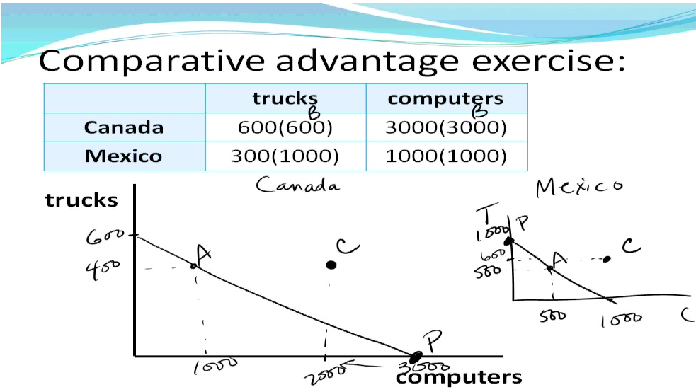
Notes:
Choose any point on the PPF, doesn’t matter where (except the end points, won’t work if it is there)
Canada is better at producing computers than Mexico. So Canada has an absolute advantage in producing computers. Mexico has an absolute advantage in producing trucks.
When countries trade with each other, Canada will produce only computers. Mexico will only produce trucks. What must be traded so that both countries are better off?
i.e. Canada’s ask: 1000 computers for 400 trucks.
Canada is left with 2000 computers to consume; in exchange, Canada will be getting 400 trucks from Mexico → Canada would be outside PPF, gain!
Mexico is left with 600 trucks to consume; in exchange Mexico will get 1000 computers from Canada → Mexico will be outside PPF
Without trade, will both be at point A. Once countries specialize, both countries are both better off. As long as both countries outside PPF.
Try Country A!!! Harder…

Slide 8
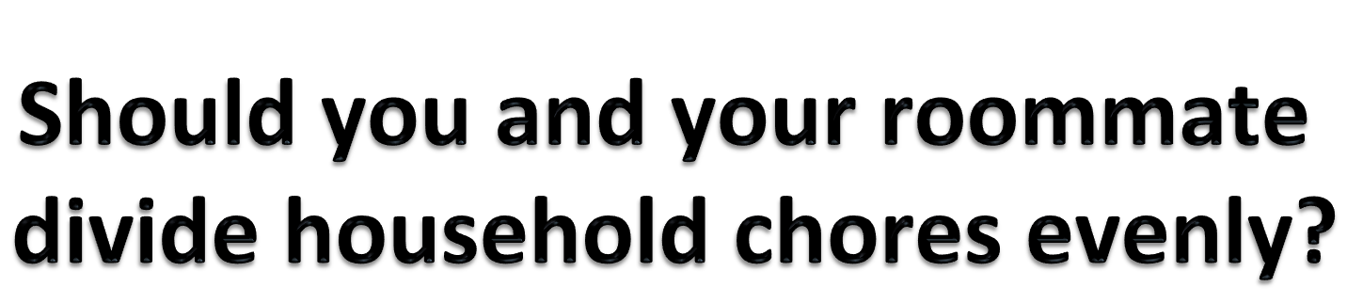
ECON 1BB3 – Introduction to Macroeconomics
Notes:
NO!

Slide 9
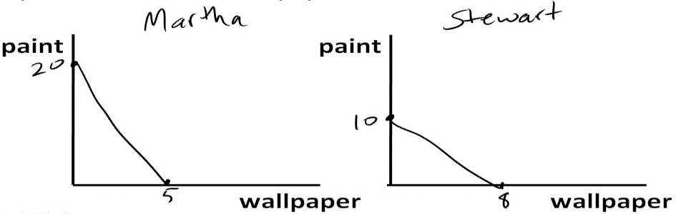
Example 1
There are 2 interior decorators who can paint & wallpaper. They have 40 hr work weeks. Martha can paint 20 rooms or wallpaper 5 rooms, Stewart can paint 10 rooms or wallpaper 8 rooms.
Notes:
Assume constant opportunity cost to make a simple model

Slide 10
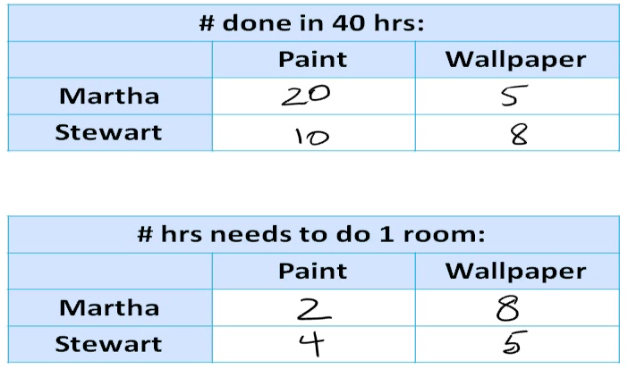
Notes:
Information can be given in any form. Know how to use information regardless of how it is given!! PRACTICE
Calculate opportunity cost now.
On the top table: bigger number is better
On the bottom table: the smaller number is better

Slide 11
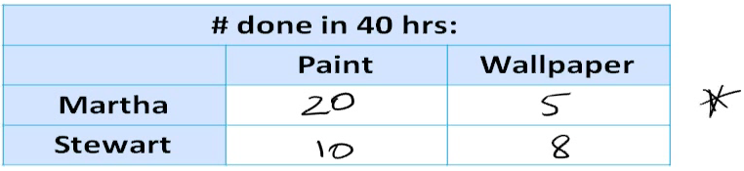
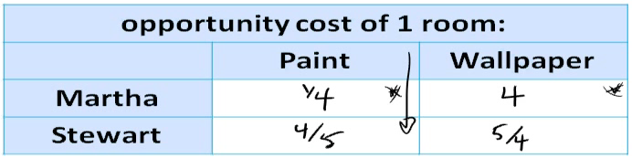

opportunity cost: whatever must be given up to obtain some item (eg. going to university instead of working)
Notes:
Use the starred table, determine opportunity cost of one room in terms of the other room.
The opportunity cost of X is the reciprocal of the opportunity cost of Y.
OC of 20 paint is 5 wallpaper
OC of 1 paint is ¼ wallpaper/paint

Slide 12
absolute advantage: the ability to a produce a good with a smaller quantity of inputs (PRODUCTIVITY)
eg. Canada needs 20 minutes to make 1 truck, USA needs 60 minutes to make 1 truck. Therefore, Canada has an absolute advantage.
comparative advantage: the ability to produce a good with a smaller opportunity cost
eg. to make 1 car it costs Canada 0.5 trucks, and USA 0.75 trucks. Therefore, Canada has a comparative advantage in making cars
can’t have comparative advantage in both goods
CA reflects the relative opportunity cost (not productivity)
Notes:
Canada has an absolute advantage because it can complete one truck quicker. Produce with a smaller quantity of inputs. (But may not be at a comparative advantage because OC may be higher)
If the opportunity costs between both countries were the same, NEITHER country has a comparative advantage. Cannot have a CA with both goods.

Slide 13
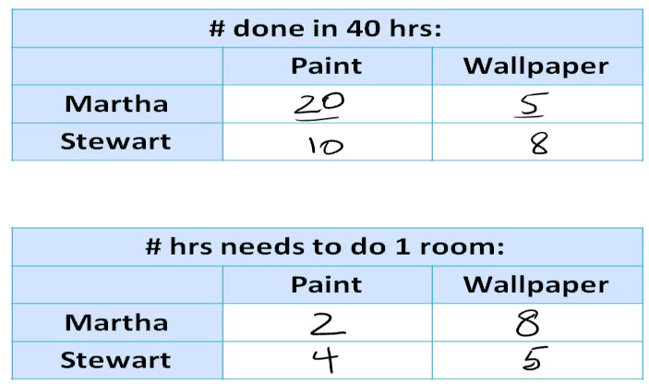
Notes:
Find absolute advantage and comparative advantage.
Martha has AA with painted rooms. Stewart has AA with wallpaper rooms.
**When a situation occurs where one person has AA in one good and the other person has AA in another good, the comparative advantage is the same as the AA. That is, Martha also has CA in painted rooms and Stewart also has CA in wallpapered rooms.
Note: Be careful of what information is being presented.
Look at the middle table. Since the # of hrs to do 1 room is given. The person that does it quicker has AA.
Look at bottom table. Can also look at opportunity cost table. The person with the lower opportunity cost will have CA.

Slide 14
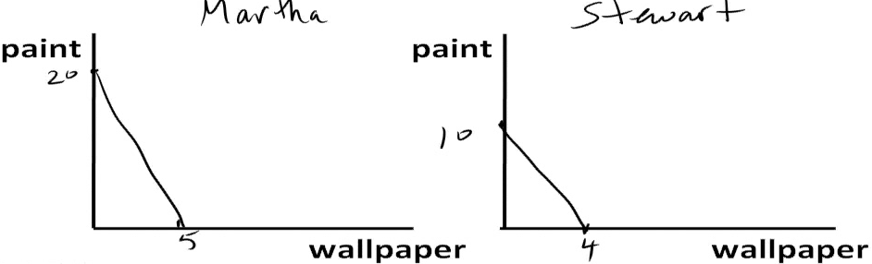
Example 2
There are 2 interior decorators who can paint & wallpaper. They have 40 hr work weeks. Martha can paint 20 rooms or wallpaper 5 rooms, Stewart can paint 10 rooms or wallpaper 4 rooms.
Notes:
Question is different/slightly harder b/c Martha has AA in both goods.

Slide 15
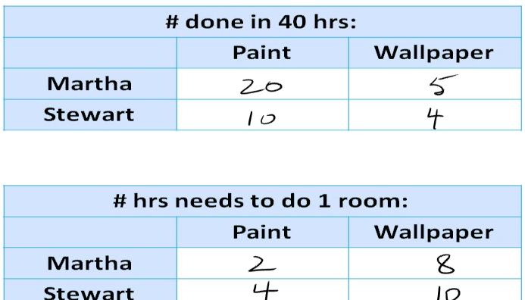
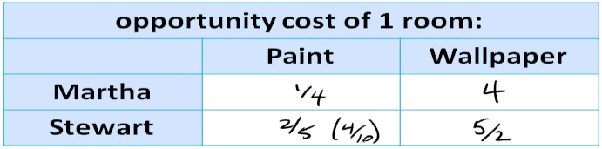
Notes:
Martha has AA in both goods.
Martha has CA in paint but not in wallpaper. Stewart has a CA in wallpaper.
No CA with the good is when the opportunity costs are the same. The ratio of producing painted room = producing wallpaper room is the same, then no one would gain from trading with one another.
Specialize in what you’re good at and trade with the other person to increase total production.
Person who is good at both goods, start at the cetner of the PPF and move towards one of the extremes
IF OC IS THE SAME FOR BOTH (Martha is 2x better at both), there is no CA

Slide 16
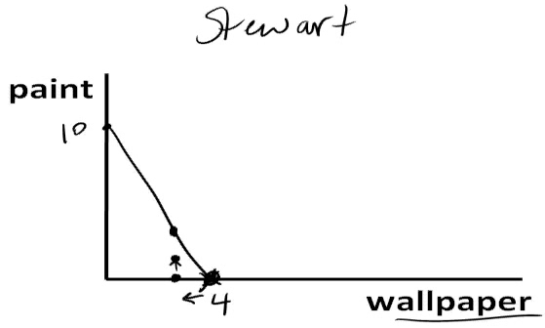
Question: Will Stewart accept 1P in exchange for 1W? (red dot)
Answer: NO, he can give up 1W and get 2.5P without trade
-→ OC is 2.5 paint/wallpaper, therefore he can afford to give up 2.5 paint
the slope of the PPF of the two ppl shows the extreme values of the terms of trade (the price will be between the two extremes – more than one price)
Notes:
***KNOW!!!!!
No. This is b/c Stewart can give up 1 W himself and make more than 1 painted room (red dot is Martha’s offer). He can make 2.5 rooms if he gives up 1 W (purple dot). The offer must be that Stewart gets at least 2.5 rooms for 1 W.
The terms of trade is the price ratio at which trade takes place. In any of the examples shown we don’t know what the actual numbers are, but we do know the extreme values in the terms of trade…which gives us…(next slide)

Slide 17

ECON 1BB3 – Introduction to Macroeconomics

Slide 18
Review
absolute advantage: the ability to a produce a good with a smaller quantity of inputs
comparative advantage: the ability to produce a good with a smaller opportunity cost
one person (or country) CANNOT have a comparative advantage in the production of both goods

Slide 19
Question #5 – Ch.3, pg.6
There are 10 million workers and each worker can produce 2 cars or 30 tonnes of wheat per year
What is the opportunity cost of producing a car in Canada? What is the opportunity cost of producing a tonne of wheat in Canada? Explain the relationship between the opportunity costs of the two goods.

Slide 20
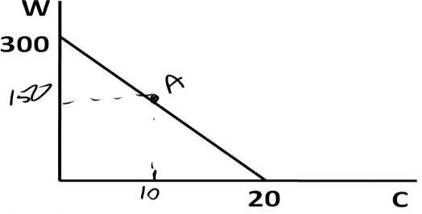
Opportunity cost
 | 1 car | 1 tonne of wheat
Canada | 15 tonnes wheat | 1/15 cars
b) Draw Canada’s production possibilities frontier. If Canada chooses to consume 10 million cars, how much wheat can it consume without trade? Label this point on the production possibilities frontier.
Notes:
Draw the PPF of the entire country. Given per worker information and the number of workers.
1 worker = 2 cars
__ workers = 10 000 000 cars
5 000 000 workers used to make 10 million cars. This means there are 5 000 000 workers left to make wheat.
5 million workers x 30 tonnes of wheat = 150 million wheat.

Slide 21
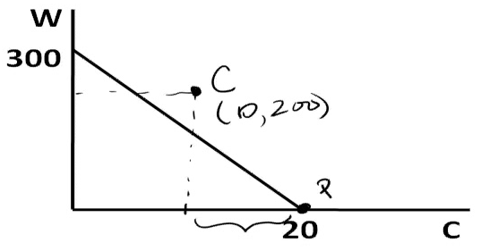
c) Now suppose that the US offers to buy 10 million cars from Canada in exchange for 20 tonnes of wheat per car. If Canada continues to consume 10 million cars, how much wheat does this deal allow Canada to consume? Label this point on your diagram. Should Canada accept the deal?
Yes. Canada should accept the deal. Canada will be able to consume 200 million tonnes of wheat
Notes:
Information tells us the Canada is going to sell 10 million cars to the US and consume 10 million cars still. This means that Canada has to produce 20 million cars.
The US offer is 20 tonnes of wheat per car. If Canada sells 10 million cars to them, Canada gets 200 million tonnes of wheat.
This means that Canada’s new consumption point is 10 million cars, 200 million tonnes of wheat. Since this point is outside Canada’s PPF, Canada should accept the deal.

Slide 22
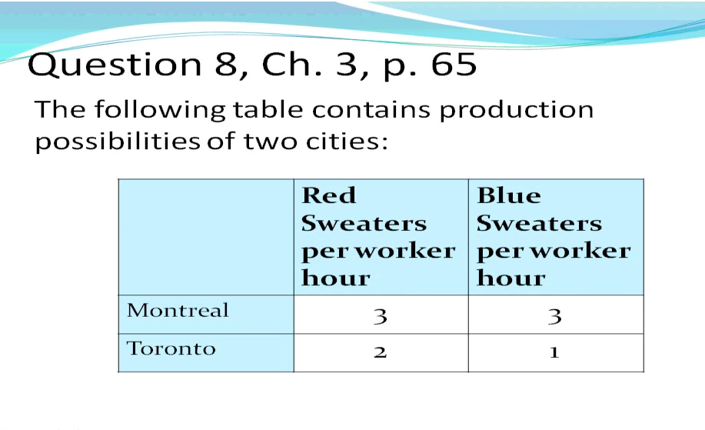

Slide 23
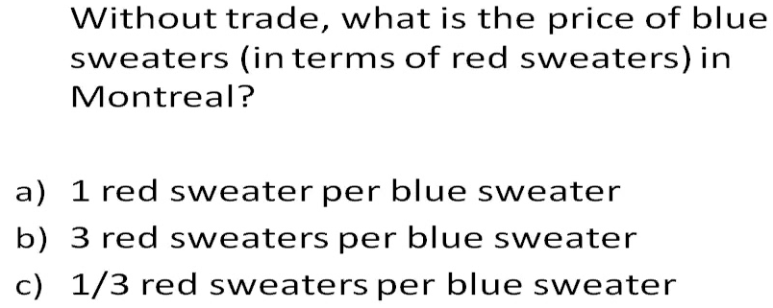
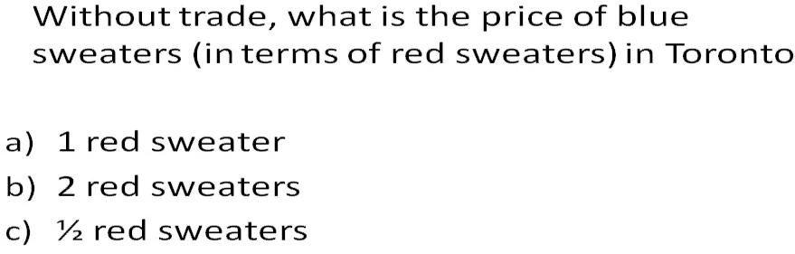
Notes:
A
B

Slide 24
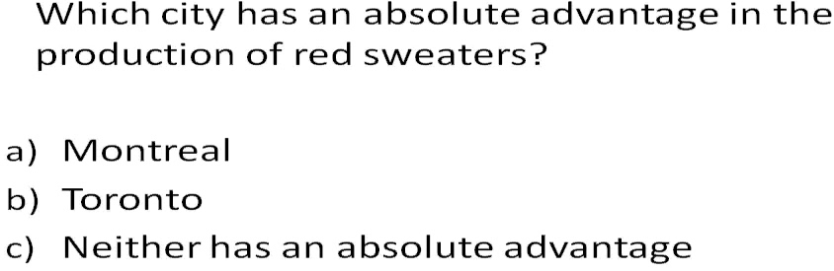
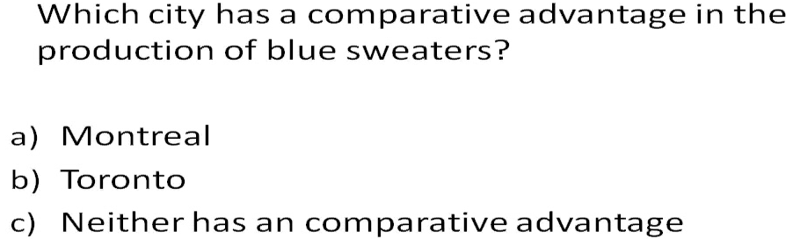
Notes:
A
A

Slide 25
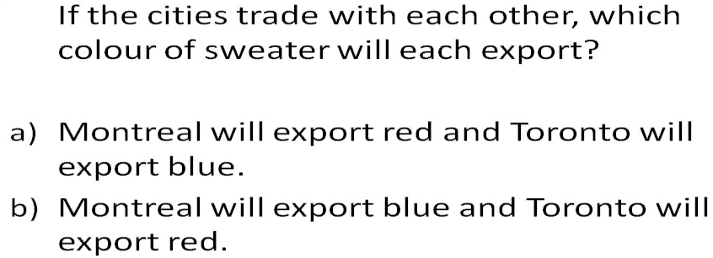
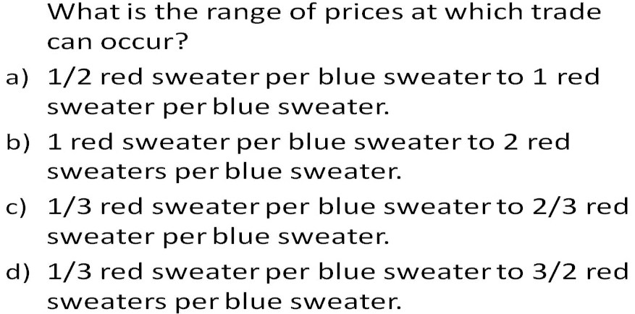
Notes:
B
The answer is the two extreme values of the goods without trade; B → it is the range at which trade should occur to make both countries better off.**??

Slide 26
Is trade a good thing?
Trade with and without restrictions
Imports and exports
Tariffs and quotas or other restrictions: to
protect domestic producers and consumers.

